Slide 1

Customer Shopping Behavior Analysis
Uncovering insights from 3,900 purchases to drive strategic business decisions

Slide 2
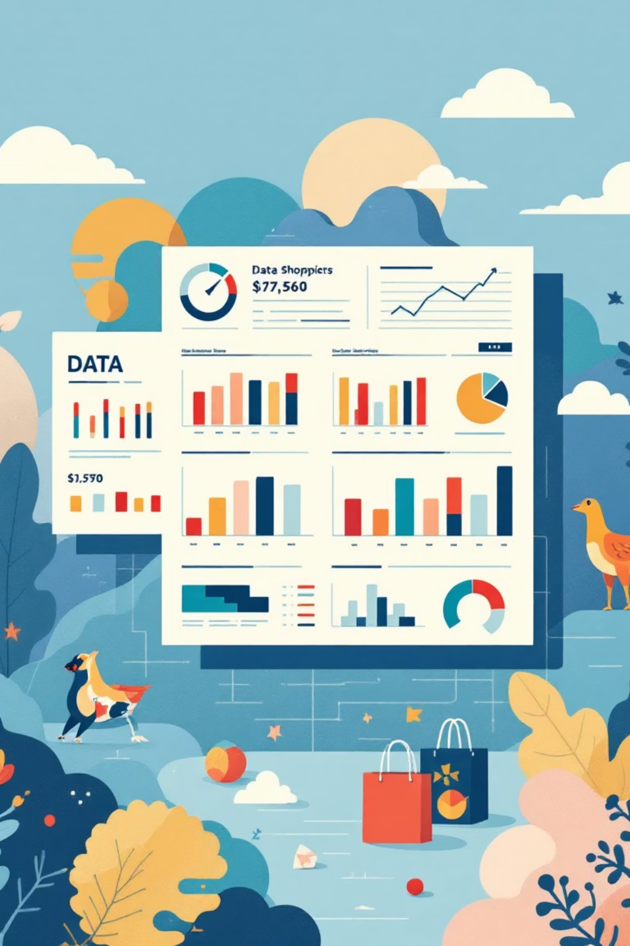
Dataset at a Glance
3,900
18
50
Total Purchases
Data Points
Locations
Transactions analyzed across all categories
Features covering demographics, purchases, and behavior
Geographic diversity across customer base
25
Products
Items tracked across 4 major categories

Slide 3
Data Preparation Journey
01
02
Data Loading & Exploration
Cleaning & Standardization
Imported dataset using pandas, analyzed structure with df.info() and summary statistics
Handled 37 missing review ratings, renamed columns to snake_case format
03
04
Feature Engineering
Database Integration
Created age_group bins and purchase_frequency_days for deeper analysis
Connected to PostgreSQL, loaded cleaned data for SQL analysis

Slide 4
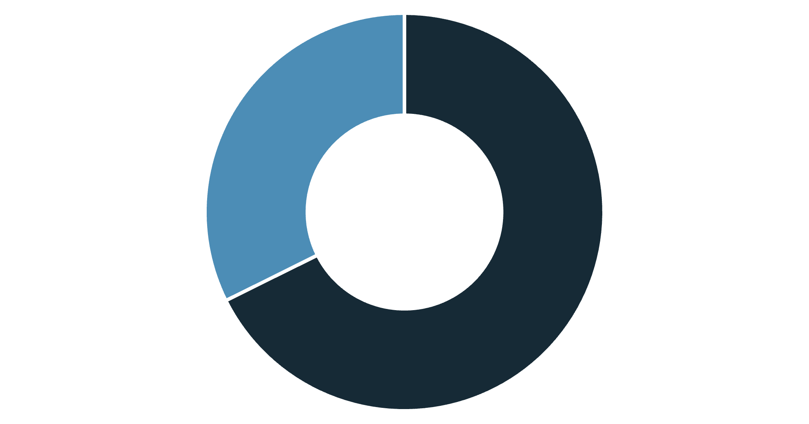
Revenue Insights by Gender
Male Customers Drive Revenue
Male shoppers generate 68% of total revenue, more than double female contribution.
This presents opportunities for targeted marketing campaigns and product positioning strategies.
Male
Female

Slide 5


Smart Spenders: Discount Users Above Average
839
21.5%
High-Value Discount Users
Share of Total
Customers who used discounts but spent above $60 average
Percentage of all customers in this valuable segment
These customers prove discounts don't always mean lower revenue—they're strategic spenders who appreciate value.

Slide 6

Top-Rated Products
Gloves
Sandals
Boots
3.86 average rating
3.84 average rating
3.82 average rating
Hat
Skirt
3.80 average rating
3.78 average rating
Customer satisfaction is consistently high across top products—leverage these in marketing campaigns.

Slide 7



Customer Loyalty Breakdown
New (83)
Returning (701)
Loyal (3,116)
Strong Loyalty Foundation
80% of customers fall into the Loyal segment, showing excellent retention.
Focus on converting New and Returning customers to maximize lifetime value.

Slide 8
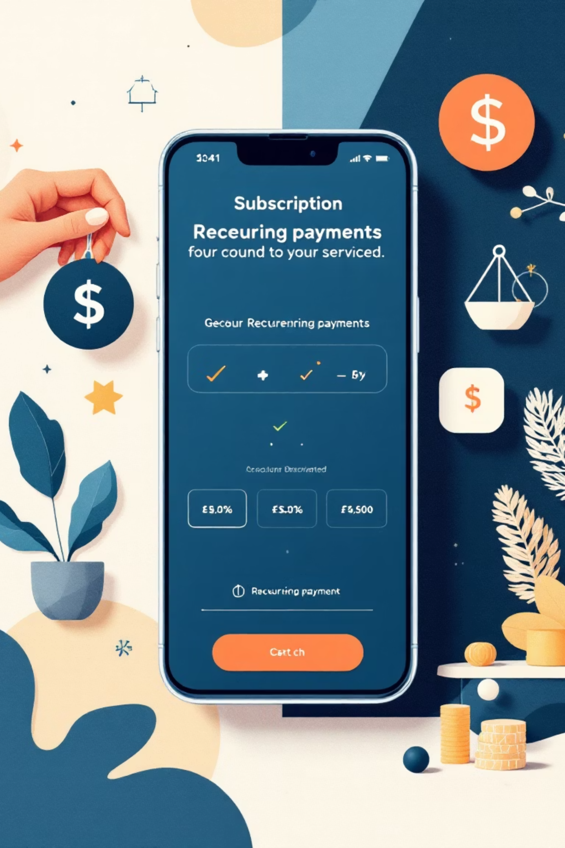

Subscription Status Analysis
Subscribers
1,053 customers (27%)
$59.49 average spend
$62,645 total revenue
Non-Subscribers
2,847 customers (73%)
$59.87 average spend
$170,436 total revenue
Key Insight: Repeat buyers (>5 purchases) show 958 subscribers vs 2,518 non-subscribers—opportunity to convert loyal customers into subscribers.

Slide 9
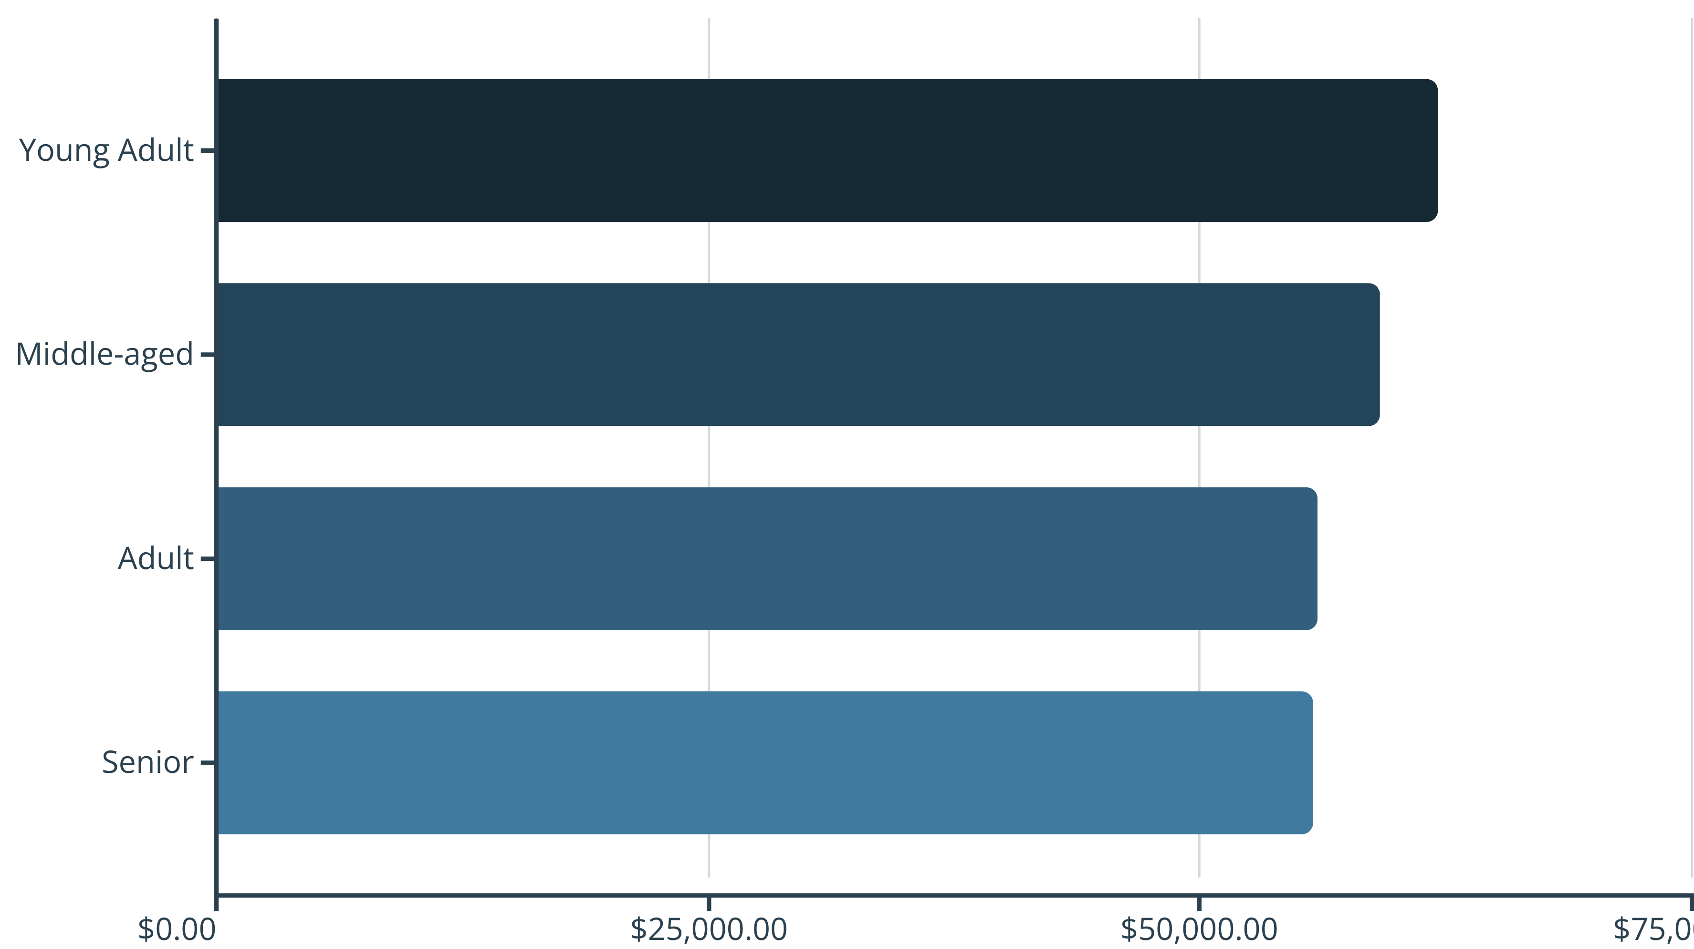
Revenue by Age Group
Young Adults lead revenue generation, but all age groups contribute relatively evenly—maintain broad appeal while targeting high-value segments.

Slide 10





Strategic Recommendations
Boost Subscriptions
Promote exclusive benefits to convert loyal repeat buyers into subscribers
Loyalty Programs
Reward repeat buyers to accelerate movement into Loyal segment
Review Discount Policy
Balance sales boosts with margin control—839 high spenders prove discounts work strategically
Product Positioning
Highlight top-rated products (Gloves, Sandals, Boots) in marketing campaigns
Targeted Marketing
Focus on Young Adults, male customers, and express-shipping users for maximum ROI

